Slide 1

The beginning of the end:
An update on the NIST PQC “Competition”
Dustin Moody
NIST PQC team
Cryptographic Technology Group
Computer Security Division
Information Technology Lab

Slide 2
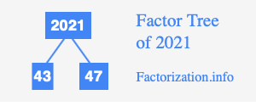
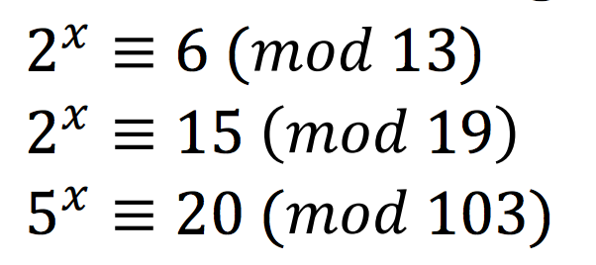
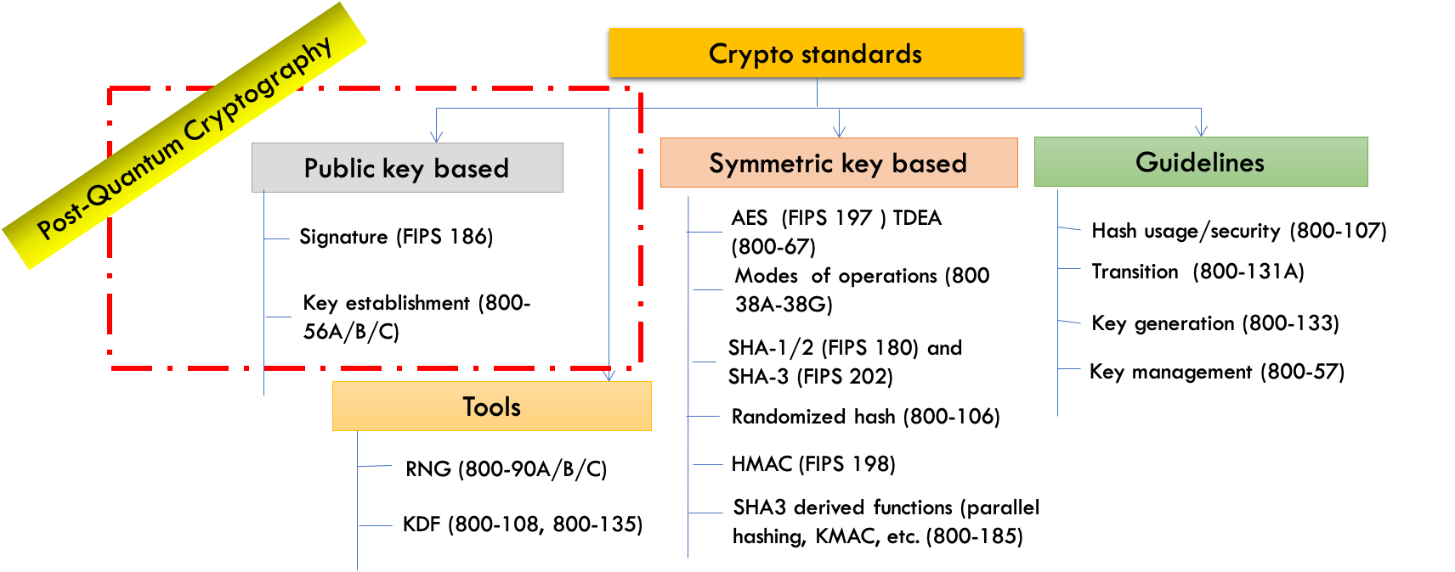
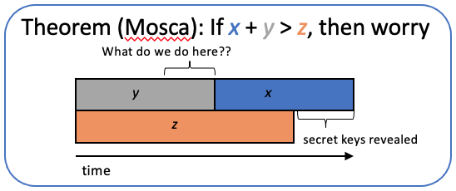
Why we’re here
NIST public-key crypto standards
  SP 800-56A: Recommendation for Pair-Wise Key-Establishment Schemes Using Discrete Logarithm Cryptography
  SP 800-56B: Recommendation for Pair-Wise Key-Establishment Using Integer Factorization Cryptography
  FIPS 186: The Digital Signature Standard
vulnerable to attacks from a (large-scale) quantum computer
Shor’s algorithm would break RSA, ECDSA, (EC)DH, DSA
Symmetric-key crypto standards would also be affected, but less dramatically
Notes:
Would break factoring, discrete log
Quantum computers progressing
Need to have standards done much sooner
PQC is this field

Slide 3
2016 - Call for Proposals
NIST called for PQC algorithms for new public-key crypto standards
  Digital signatures
  Encryption/key-establishment
To be evaluated on security,
performance, and algorithm characteristics
Our role is managing a process of achieving community consensus in a transparent and timely manner
Level | Security Description
I | At least as hard to break as AES128 (exhaustive key search)
II | At least as hard to break as SHA256 (collision search)
III | At least as hard to break as AES192 (exhaustive key search)
IV | At least as hard to break as SHA384 (collision search)
V | At least as hard to break as AES256 (exhaustive key search)
Notes:
We didn’t call it a “competition”

Slide 4

The 1st and 2nd Rounds
Round 1 (Dec ‘17 – Jan ‘18)
  69 candidates and 278 distinct submitters
  Apr 2018, 1st NIST PQC Standardization conference
  Almost 25 schemes broken/attacked
  NISTIR 8240, NIST Report on the 1st Round
Round 2 (Jan ‘18 – Jul ‘20)
  26 candidates
  Aug 2019 – 2nd NIST PQC Standardization conference
  Schemes broken/attacked: LAC, LedaCrypt, Round5, Rollo, RQC, LUOV, MQDSS, qTESLA
  NISTIR 8309, NIST Report on 2nd Round
Both rounds: research, cryptanalysis, pqc-forum, official comments, benchmarking, mergers
 | Signatures | KEM/Encryption | Overall
Lattice-based | 5 | 21 | 26
Code-based | 2 | 17 | 19
Multi-variate | 7 | 2 | 9
Symmetric based | 3 |  | 3
Other | 2 | 5 | 7
Total | 19 | 45 | 64
 | Signatures | KEMs/Encryption | Total
Lattice-based | 3 | 9 | 12
Code-based | 0 | 7 | 7
Multi-variate | 4 | 0 | 4
Symmetric-based | 2 |  | 2
Other | 0 | 1 | 1
Total | 9 | 17 | 26
Notes:
A lot of lattice and code-based KEMs, but diversity
Lots of the lattices were fairly similar
More KEMs than signatures
Preserved diversity and selected most promising ones. Some hard choices
Report explained why we selected each, and gave some comments

Slide 5
So where are we now?
3rd Round: 7 Finalists and 8 Alternates
  Finalists: most promising algorithms we expect to be ready for standardization at the end of the 3rd round
  Alternates: candidates for potential standardization, most likely after another (4th) round
 | Finalists | Alternates
KEMs/Encryption | Kyber NTRU SABER Classic McEliece | Bike FrodoKEM HQC NTRUprime SIKE
Signatures | Dilithium Falcon Rainbow | GeMSS Picnic SPHINCS+

Slide 6
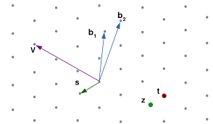
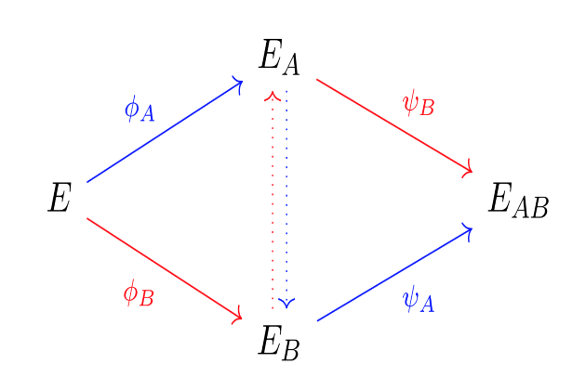
The KEMs
The lattice KEMs
  The finalists Kyber, NTRU, SABER are based on structured lattices
    All three have good performance (in terms of efficiency and key/ciphertext sizes)
    NIST expects to select at most one for standardization
  The alternates NTRUprime and FrodoKEM are also based on lattices
    NTRUprime uses structured lattices, while FrodoKEM does not
The other KEMs
  The finalist Classic McEliece is code-based
    Older, Very large public keys, small ciphertexts
  The alternates BIKE and HQC are based on structured codes
    Both have much smaller public key sizes than Classic McEliece
  The alternate SIKE is based on isogenies of elliptic curves
    Small key/ciphertext sizes, slower than other candidates
(001)
(011)
(101)
(111)
(000)
(010)
(100)
(110)

Slide 7

The Signatures
The finalists Dilithium and Falcon are both based on structured lattices
  Both have good performance
  NIST expects to select at most one for standardization
The alternate Picnic is based on zero-knowledge proofs and a block cipher
The alternate SPHINCS+ is based on the security of hash functions
  The security of SPHINCS+ is very well understood
There are two multivariate schemes: the finalist Rainbow, and the alternate GeMSS
  Both have large public keys, and very small signature sizes
  Cryptanalytic results during the 3rd round have created some concerns about the security of both multivariate schemes Rainbow and GeMSS

Slide 8
The state of the signatures
NIST wants to ensure we have diversity of signatures available
  If the multivariate schemes are not selected (or need more time), then we are left with 2 lattice-based finalists, and 2 symmetric-based alternates
  The symmetric-based algorithms may not be suitable for many use cases
Jan 2021 pqc-forum post from NIST:
  NIST mentions the possibility of considering SPHINCS+ for standardization at the end of the 3rd Round
  Also noted that NIST may call for new signature algorithms in the future
    (see next slide)
Notes:
If those two schemes are out, there are only 4 signatures under consideration

Slide 9
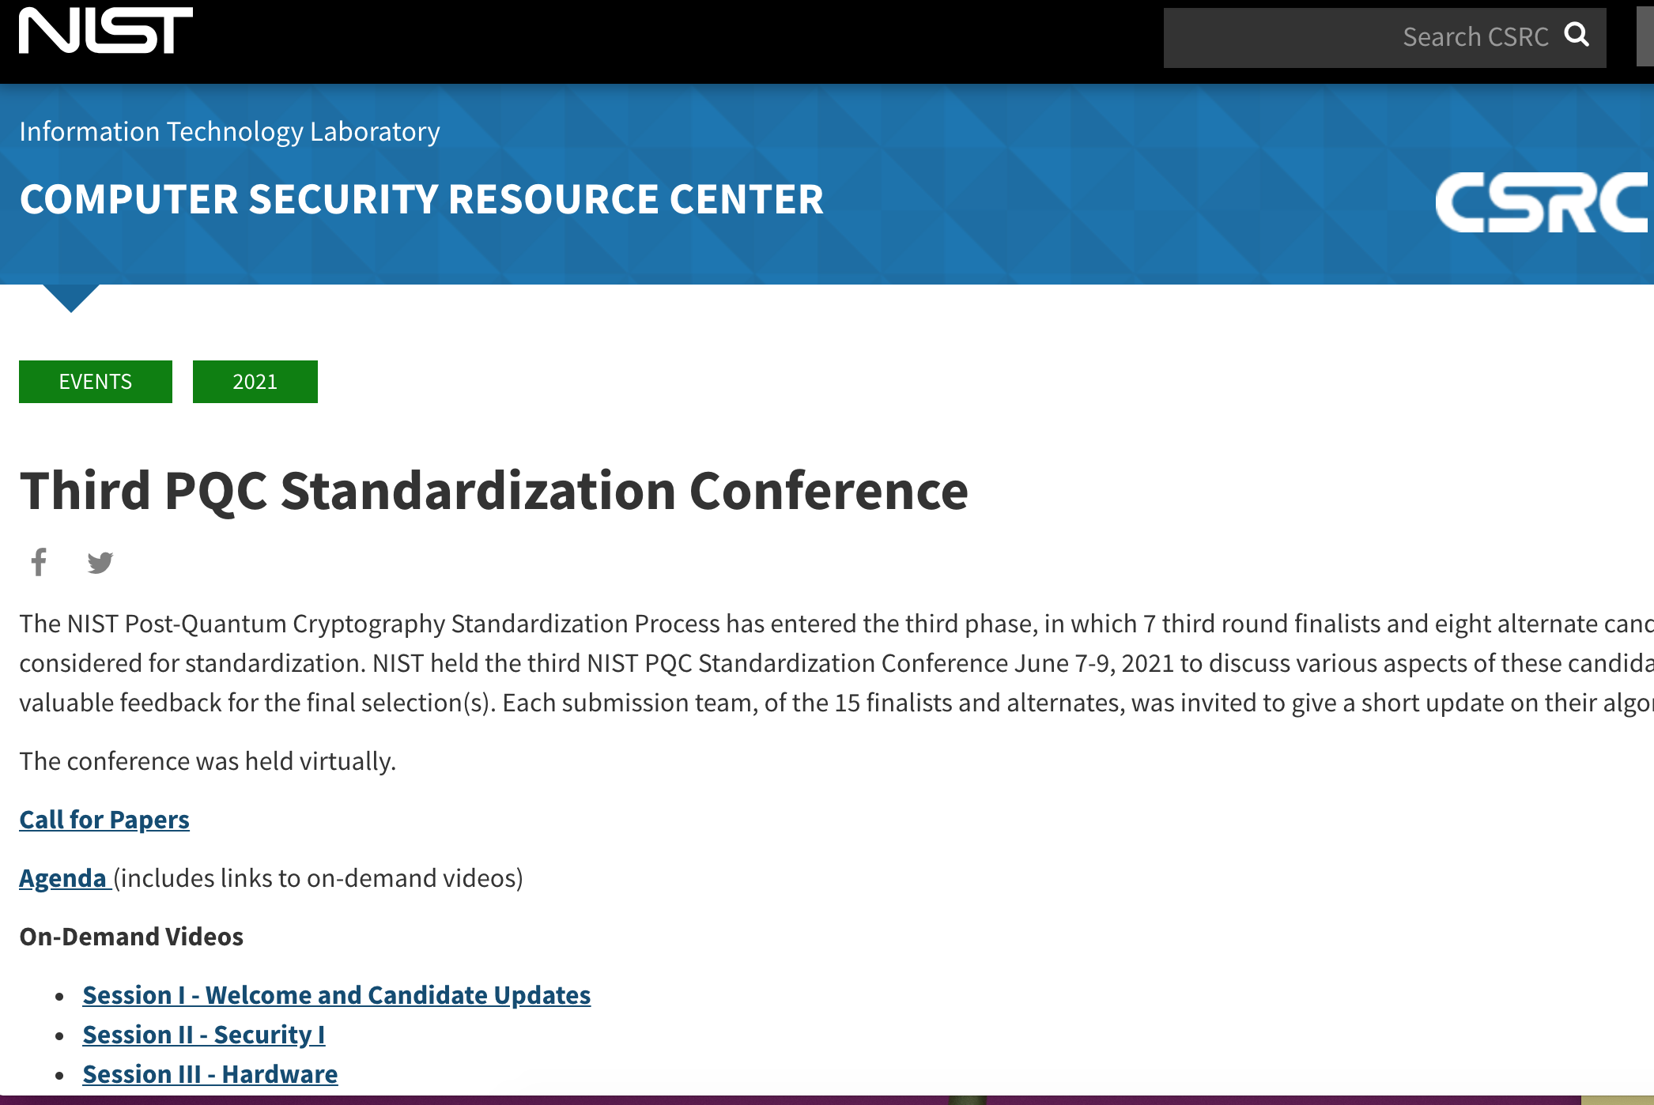
The 3rd NIST PQC Conference
June 2021, held virtually
  Over 400 participants
  38 accepted papers
  15 candidate team updates
  Video, slides, papers posted at our website
Announcements:
  4th round
  On-ramp for signatures at end of the 3rd Round
Ongoing research:
  Hardware and software implementations, side-channel analysis, cryptanalysis of 3rd round candidates, PQC in applications and protocols, formal verification, security, variants of candidates, etc

Slide 10

What lies ahead….
End of 2021/Start of 2022
  The 3rd Round will end sometime around here
  NIST will announce which finalist algorithms it will standardize
    (As mentioned previously, also potentially SPHINCS+)
  This will include algorithms which will be able to be used by most applications
  NIST will issue a Report on the 3rd Round to explain our decisions
NIST will also announce any candidates advancing to 4th round
  The 4th round will similarly be 12-18 months
  These algorithms will be for a diversified portfolio, or for applications with different performance needs
In addition, NIST will issue a new Call for Proposals for signatures – see next slide
2022-2023: We expect to release draft standards for public comment
2024: The first set of standards will hopefully be finalized
Notes:
4th round algorithms will likely be focusing more on the KEMs.
Choosing a code-based one, and/or selecting SIKE if we want it.
If choose Sphincs+, less of a need for picnic, but could still be considered

Slide 11

An on-ramp for signatures
At the conclusion of the 3rd Round, NIST will issue a new Call for Proposals
  There will be a deadline for submission, likely 6 months – 1 year
  This will be much smaller in scope than main NIST PQC effort
  The main reason for this call is to diversify our signature portfolio
  These signatures will be on a different track than the candidates in the 4th round
We are most interested in a general-purpose digital signature scheme which is not based on structured lattices
  We may be interested in other signature schemes targeted for certain applications. For example, a scheme with very short signatures.
The more mature the scheme, the better.
NIST will decide which (if any) of the received schemes to focus attention on
Notes:
Remind why we’re doing this
Don’t want it to interfere with the 3rd round

Slide 12




How will NIST make its decisions?
Using the evaluation criteria:
Security
  Security levels offered, (confidence in) security proof, known attacks, classical/quantum complexity
Performance
  Size of parameters, speed of KeyGen, Enc/Dec, Sign/Verify, decryption failures
Algorithm and implementation characteristics
  IP issues, side channel resistance, simplicity and clarity of documentation
For the lattice KEMs, the main decision will be Kyber/NTRU/Saber
Similarly for lattice signatures, the main decision will be Dilithium/Falcon
Any other algorithms selected will be their own distinct decision
1st round
2nd round
3rd round

Slide 13
Patent and IPR issues
This is a very complicated area
We acknowledge the impact of encumbered technology on adoption
NIST is actively engaging to try to resolve known IPR issues on the candidates
When we have something concrete, we will share it
Note: it may not be possible for NIST to resolve all IP concerns
In light of the above, NIST believes the discussion should be around the impact of IP, and how we should factor these issues into our decision-making
  NIST would very much appreciate feedback on the impact of potentially selecting algorithms which may be encumbered
Notes:
NIST will consider the IPR impact when making selections. Actually, even though we did not receive a lot feedback, it is clear that the candidates with IPR issues would not be adopted.
Really emphasize not enough public feedback on impact of IP
As was described in the original Call for Algorithms, and discussed on the PQC Forum, NIST has been reviewing intellectual property claims against the PQC finalists.
While submitters were required to disclose applicable patents and declare their intent for regarding licensing, a challenge in this process has been addressing IP claims by third parties, particularly against lattice-based candidates.
NIST has been engaging IP holders to discuss applicability and intentions regarding licensing, including preliminary discussions with CNRS.
While it is not clear whether these patents apply to the PQC finalists, we recognize the impact that even questions over IPR and licensing terms can have on the adoption of cryptographic algorithms.
While we intend to word towards clarity on these issues, we note that there are no easy answers or solutions to these questions, and we want to acknowledge NIST’s constraints up-front to avoid potential misunderstandings.
We do not expect definitive answers on the applicability of patent during the timeline of this selection process.
Furthermore, NIST does not have significant resources to license patents on behalf of implementers and users of cryptographic technologies.
Ultimately, we want to hear from the community how intellectual property considerations will impact their adoption of any of the finalists, including questions over applicability and the effect of royalty-bearing licenses.
We welcome discussion of these issues, on the PQC Forum and other venues, as input to the selection and standardization process.

Slide 14
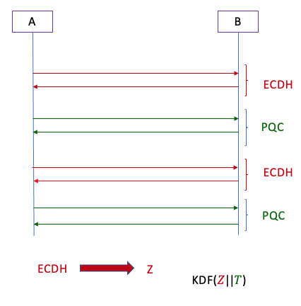
The transition to PQC
NIST will issue guidance on the transition
  NIST SP 800-131A Revision 2 “Transitioning the Use of Cryptographic Algorithms and Key Lengths”
  Examples: Three-key Triple DES, SHA-1, keys with strength < 112 bits
An update from last year on SP 800-56C Rev. 2 allows for a “hybrid mode” to combine shared secrets for key-establishment
  In other words, you can combine an unapproved (i.e. a PQC) algorithm with a NIST-approved algorithm and still receive FIPS validation
Notes:
Three-key Triple DES
Encryption - Deprecated through 2023 Disallowed after 2023
Decryption - Legacy use
SHA-1
Digital signature generation - Disallowed, except where specifically allowed by NIST protocol-specific guidance
Digital signature verification - Legacy use
Non-digital signature applications – Acceptable
Key establishment methods with strength < 112 bits (e.g. DH mod p, |p| < 2048 )
Disallowed

Slide 15
Getting ready for PQC
The National Cybersecurity Center of Excellence (NCCoE) has a project for Migration to PQC
Goals:
  Align and complement the NIST PQC standardization activities
  Raise awareness and develop practices to ease the migration to PQC algorithms
  Deliver white papers, playbooks, and demonstrable implementations for organizations
  Target organizations that provide cryptographic standards and protocols and enterprises that develop, acquire, implement, and service cryptographic products
Join the community of interest and receive updates: applied-crypto-pqc@nist.gov
Notes:
In partnership with DHS

Slide 16
Stateful Hash-based Signatures
Stateful hash-based signatures have been around since the 1970s
  They require careful management of the state, and as such should only be used in certain applications
  They have a limited lifetime
  Their security relies on assumptions about hash functions, not number theory
Oct. 2020 - NIST published SP 800-208, Recommendation for Stateful Hash-based Signature Schemes
  The SP approves certain parameter sets for XMSS and LMS
  XMSS and LMS are in IETF documents RFC 8391 and RFC 8554
  ISO/IEC JTC 1 SC27 WG2 also initiated a project to standardize stateful-hash based signatures as in ISO/IEC 14888-4

Slide 17

Conclusion
We can start to see the end?
NIST is grateful for everybody’s efforts
Check out www.nist.gov/pqcrypto
  Sign up for the pqc-forum for announcements & discussion
  Contact us at: pqc-comments@nist.gov

